Slide 1
Data Science – Project 1
Intermediate Presentation
Notes:
Michea

Slide 2
Dataset refresh
Dataset Overview:
Contains individual records of people.
Study on stress and depression level related to university pressure, lifestyle, and other factors.
What Each Row Represents:
Each row represents one person’s profile.

Slide 3
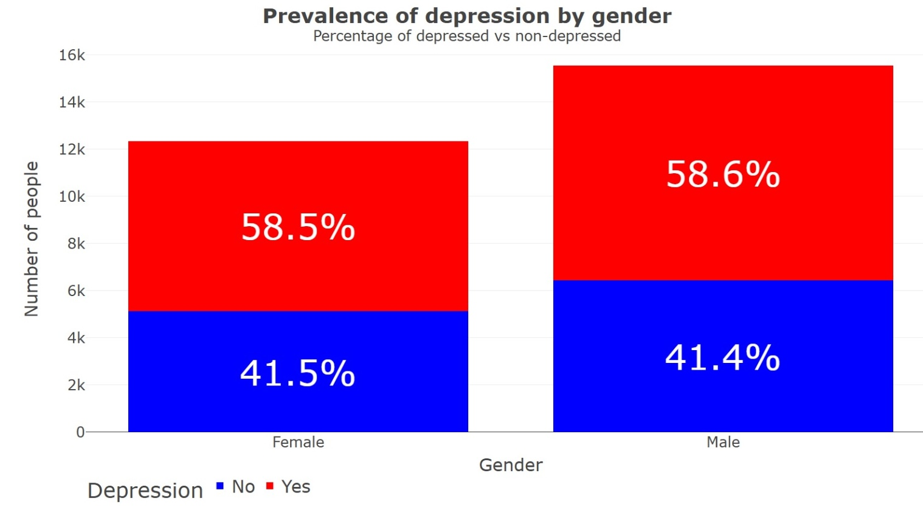
Depression by gender

Slide 4
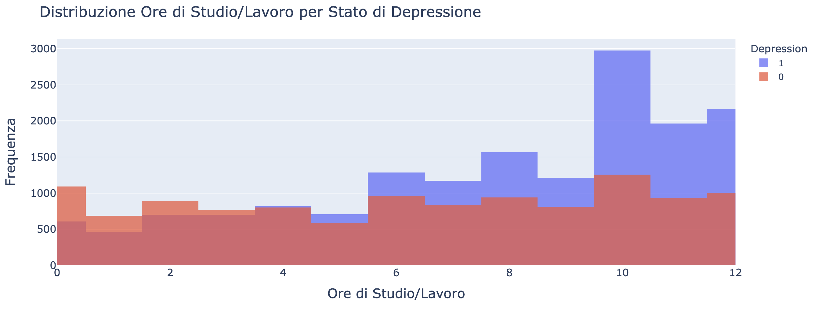
Work/Study Hours & Depression

Slide 5
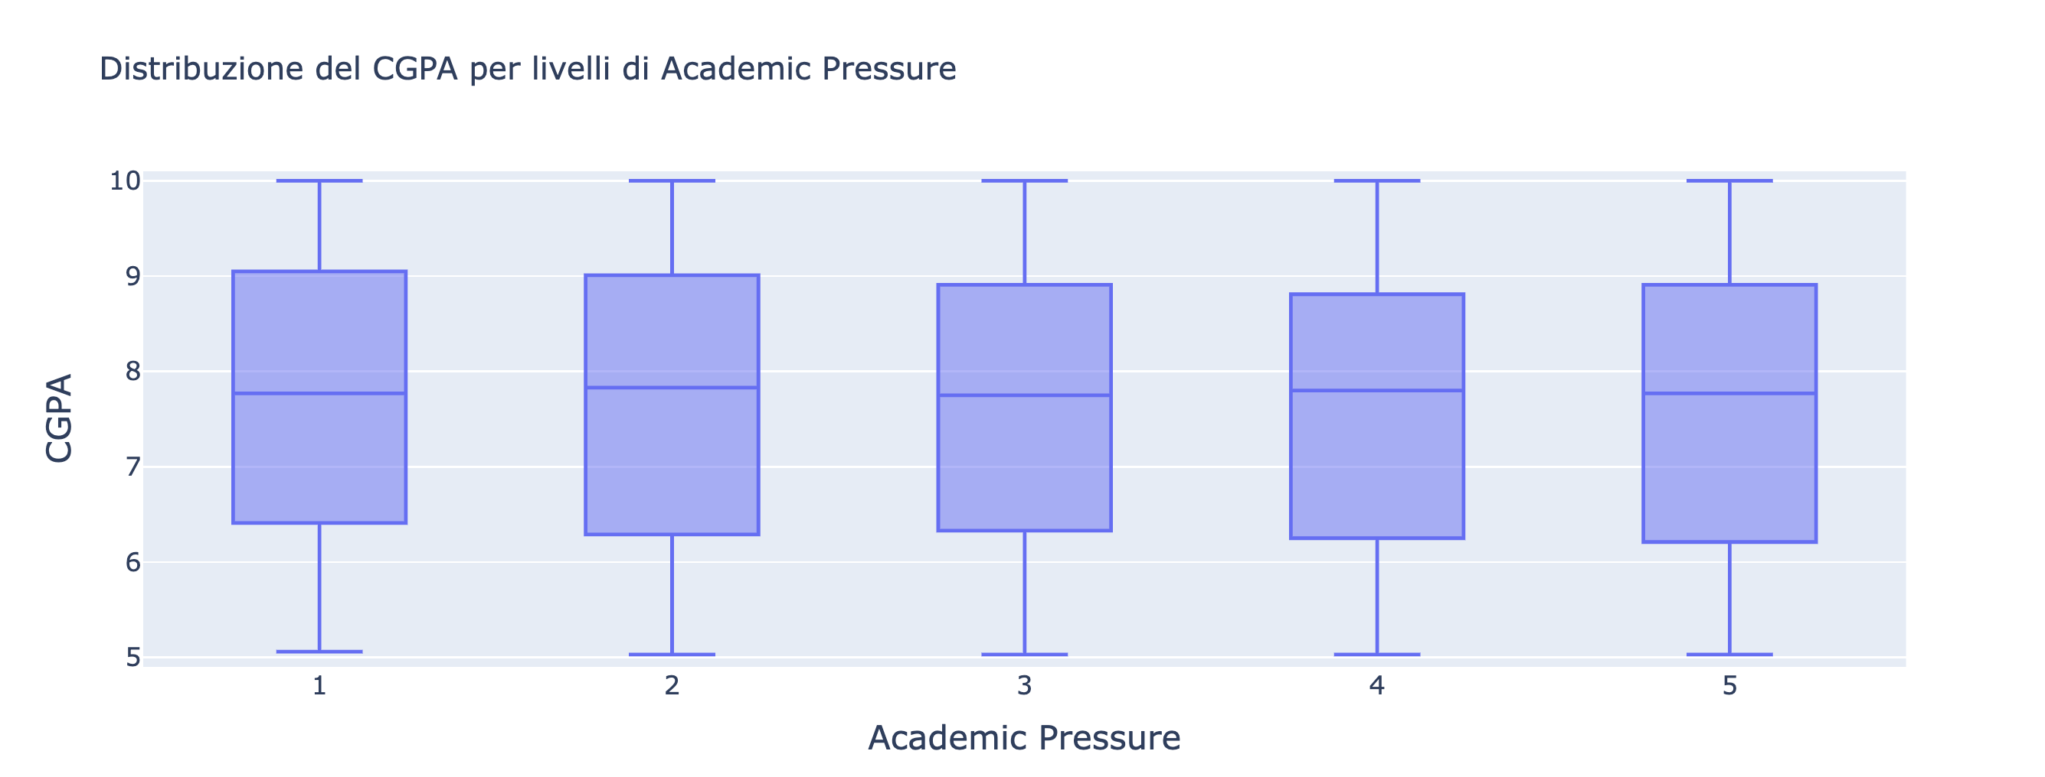
Accademic pressure & CGPA

Slide 6
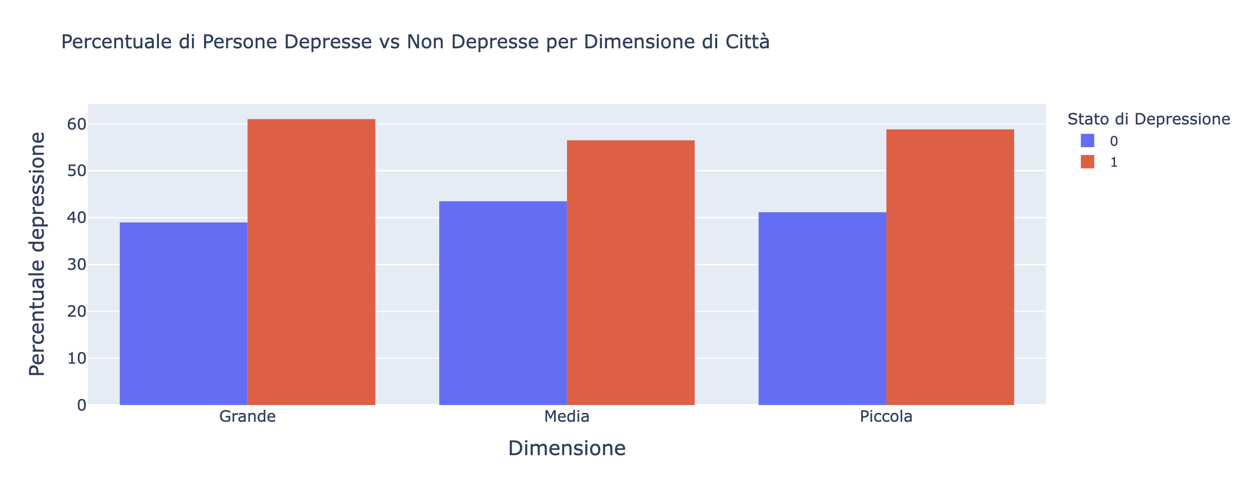
City size & depression ratio

